Slide 1
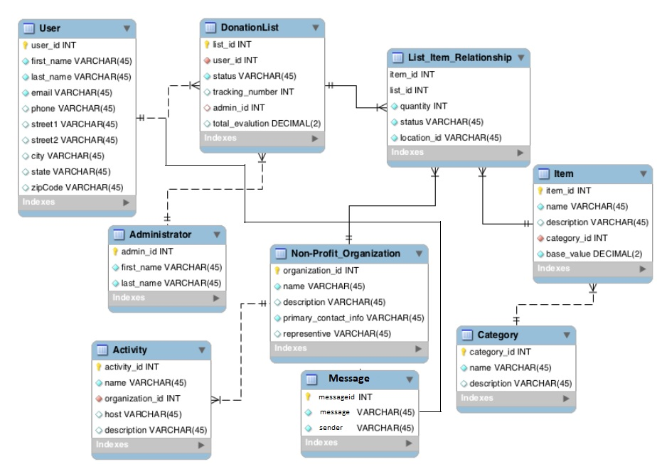
DonationPlace Solution -Logical ER Diagram
Key Shape: Primary Key
Red: Foreign Key
Filled: Not-Null

Slide 2
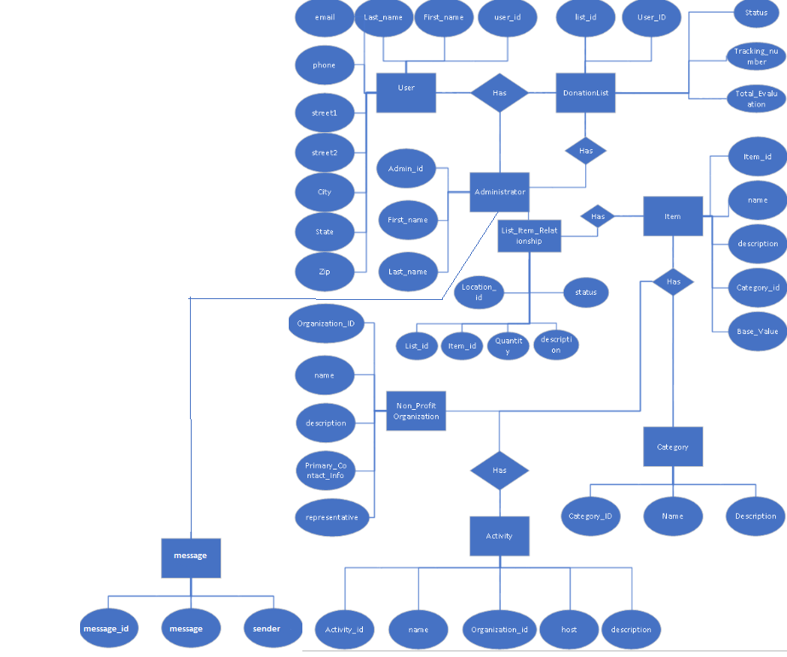
DonationPlace Solution Conceptual ER Diagram

